Slide 1

Lecture 6

Slide 2
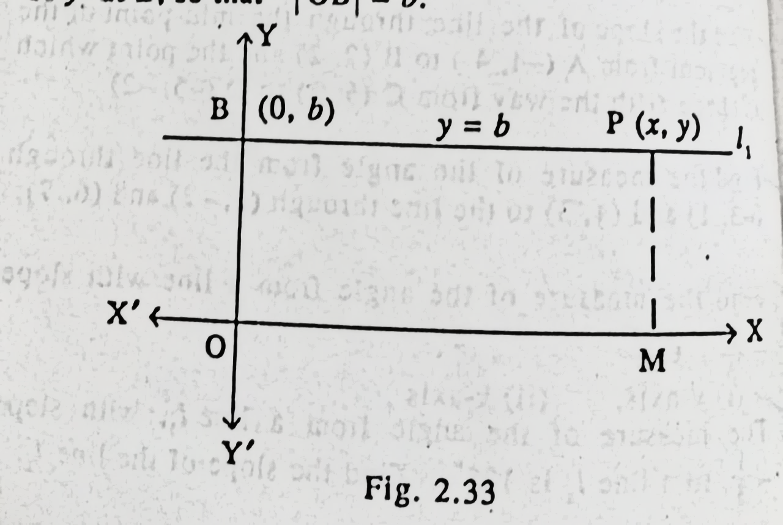
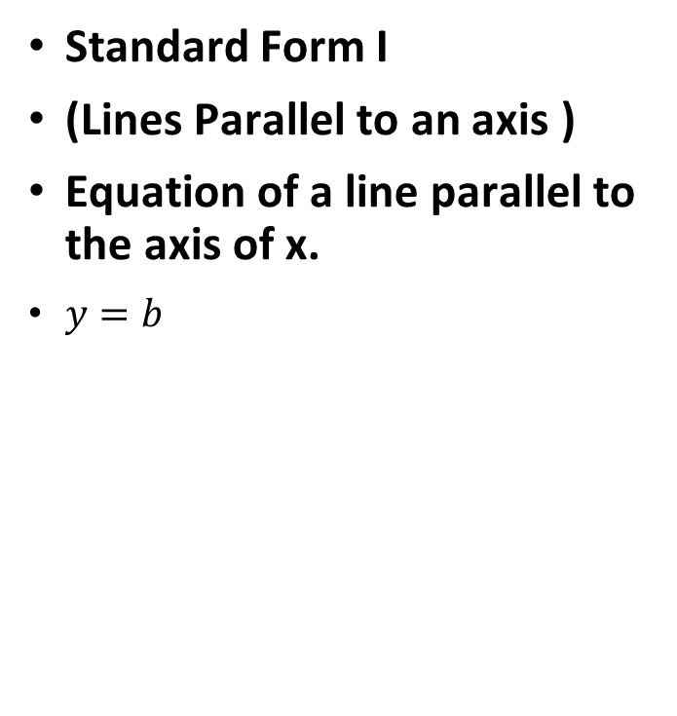
STANDARD FORMS OF THE EQUATION OF STRAIGHT LINE
Standard Form I
(Lines Parallel to an axis )
Equation of a line parallel to the axis of x.
$y=b$

Slide 3
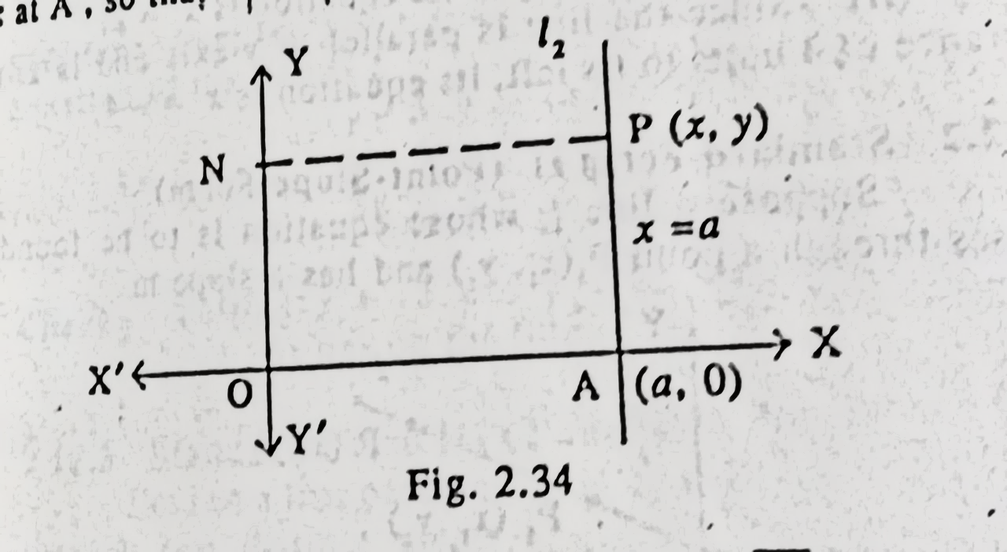
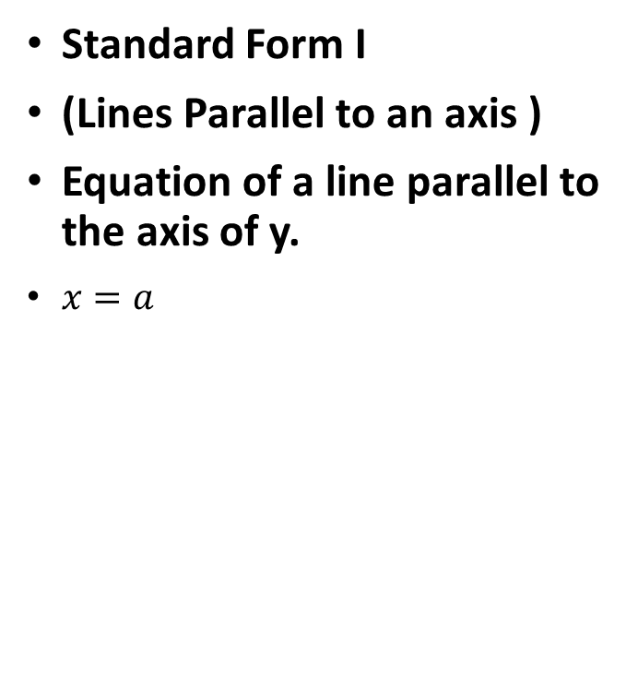
STANDARD FORMS OF THE EQUATION OF STRAIGHT LINE
Standard Form I
(Lines Parallel to an axis )
Equation of a line parallel to the axis of y.
$x=a$

Slide 4
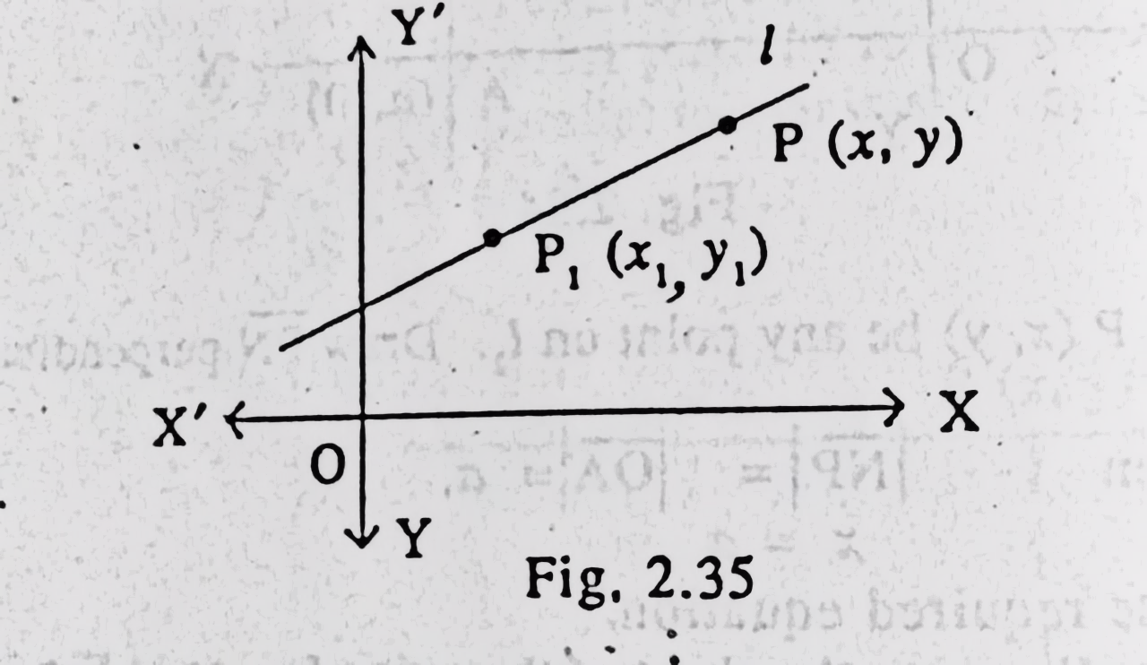
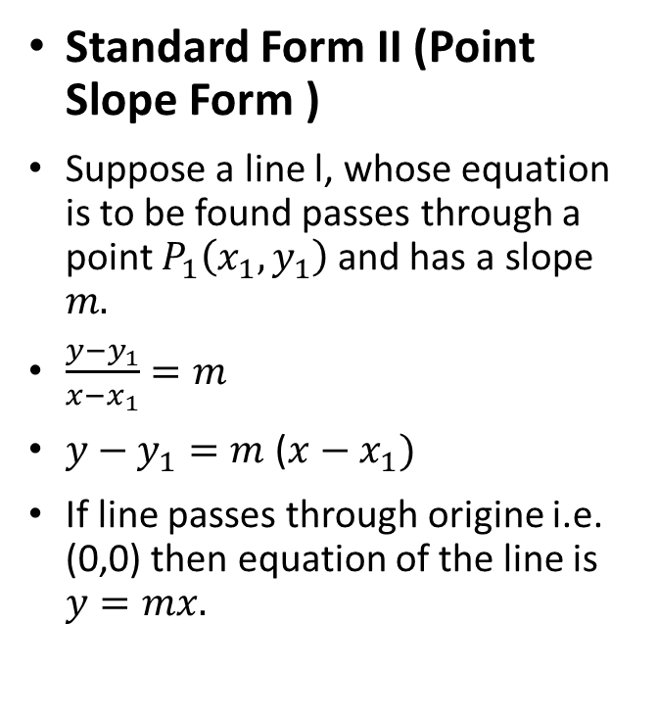
STANDARD FORMS OF THE EQUATION OF STRAIGHT LINE
Standard Form II (Point Slope Form )
Suppose a line l, whose equation is to be found passes through a point $P_{1}\left(x_{1},y_{1}\right)$and has a slope $m.$
$\frac{y−y_{1}}{x−x_{1}}=m$
$y−y_{1}=m$ ($x−x_{1})$
If line passes through origine i.e. (0,0) then equation of the line is $y=mx.$

Slide 5
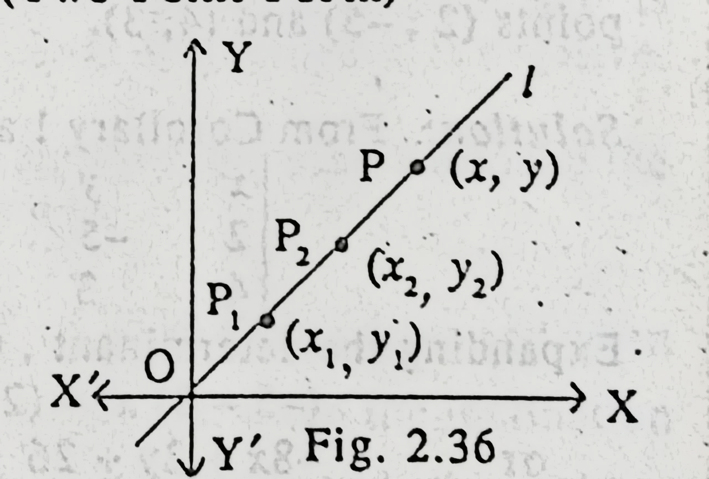
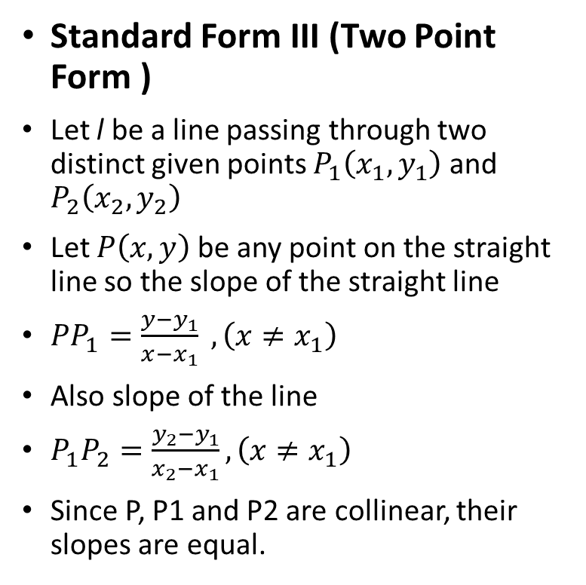
STANDARD FORMS OF THE EQUATION OF STRAIGHT LINE
Standard Form III (Two Point Form )
Let l be a line passing through two distinct given points $P_{1}\left(x_{1},y_{1}\right)$ and $P_{2}\left(x_{2},y_{2}\right)$
Let $P\left(x,y\right)$ be any point on the straight line so the slope of the straight line
$PP_{1}=\frac{y−y_{1}}{x−x_{1}} , \left(x≠x_{1}\right)$
Also slope of the line
$P_{1}P_{2}=\frac{y_{2}−y_{1}}{x_{2}−x_{1}}, \left(x≠x_{1}\right)$
Since P, P1 and P2 are collinear, their slopes are equal.

Slide 6
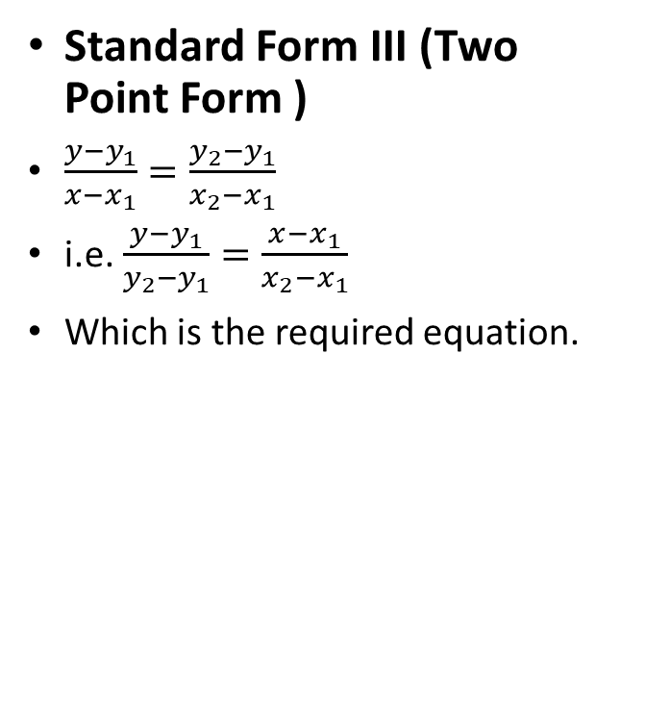
STANDARD FORMS OF THE EQUATION OF STRAIGHT LINE
Standard Form III (Two Point Form )
$\frac{y−y_{1}}{x−x_{1}}=\frac{y_{2}−y_{1}}{x_{2}−x_{1}}$
i.e. $\frac{y−y_{1}}{y_{2}−y_{1}}=\frac{x−x_{1}}{x_{2}−x_{1}}$
Which is the required equation.

Slide 7
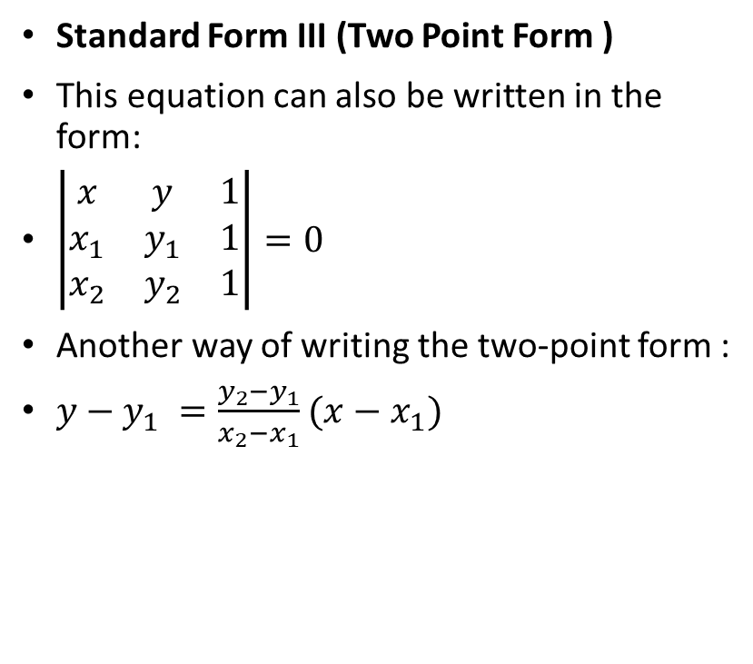
STANDARD FORMS OF THE EQUATION OF STRAIGHT LINE
Standard Form III (Two Point Form )
This equation can also be written in the form:
$\left|\begin{matrix}x & y & 1 \\ x_{1} & y_{1} & 1 \\ x_{2} & y_{2} & 1\end{matrix}\right|=0$
Another way of writing the two-point form :
$y−y_{1} =\frac{y_{2}−y_{1}}{x_{2}−x_{1}}$ $(x−x_{1})$

Slide 8
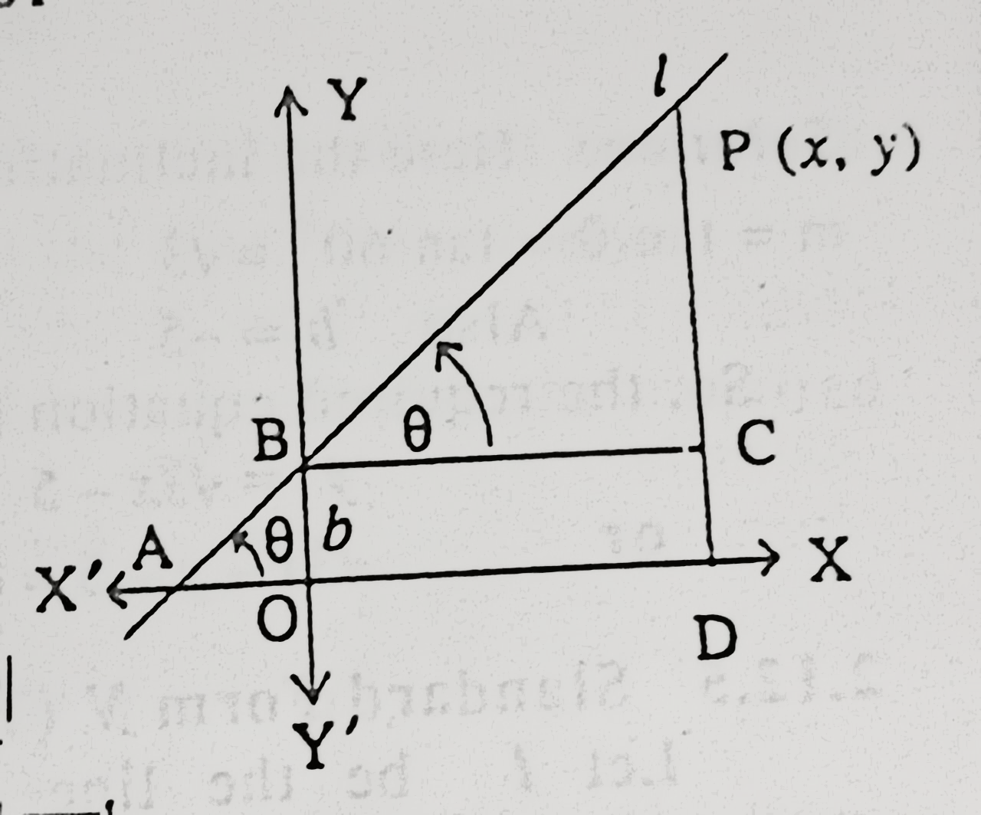
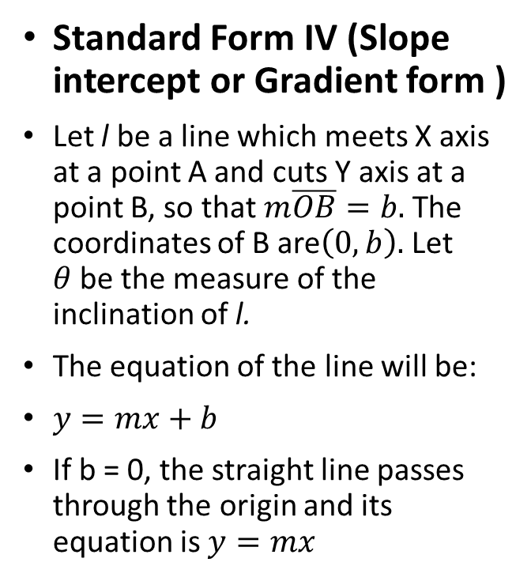
STANDARD FORMS OF THE EQUATION OF STRAIGHT LINE
Standard Form IV (Slope intercept or Gradient form )
Let l be a line which meets X axis at a point A and cuts Y axis at a point B, so that $m\overline{OB}=b.$The coordinates of B are$\left(0,b\right).$ Let $θ$be the measure of the inclination of l.
The equation of the line will be:
$y=mx+b$
If b = 0, the straight line passes through the origin and its equation is $y=mx$

Slide 9
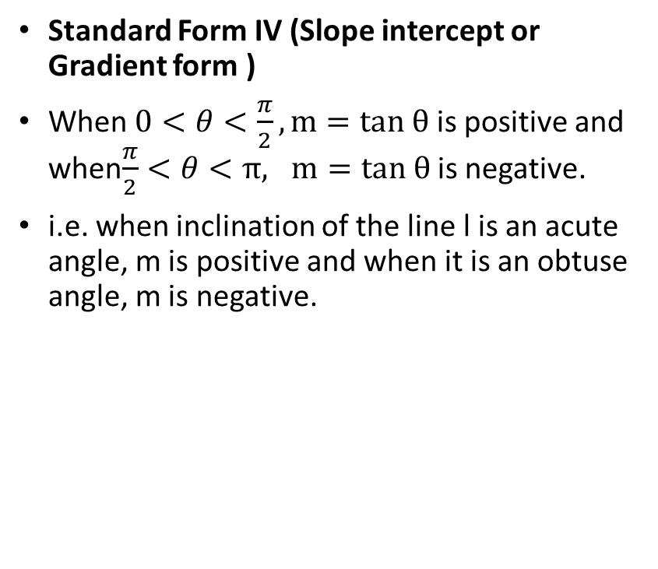
STANDARD FORMS OF THE EQUATION OF STRAIGHT LINE
Standard Form IV (Slope intercept or Gradient form )
When $0<θ<\frac{π}{2}, m=tan θ$ is positive and when$\frac{π}{2}<θ<π, m=tan θ$ is negative.
i.e. when inclination of the line l is an acute angle, m is positive and when it is an obtuse angle, m is negative.

Slide 10
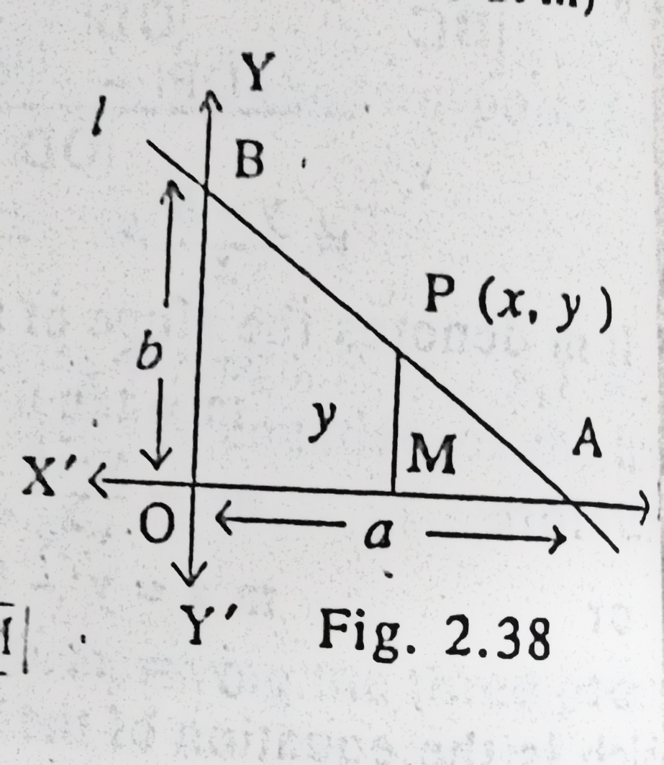
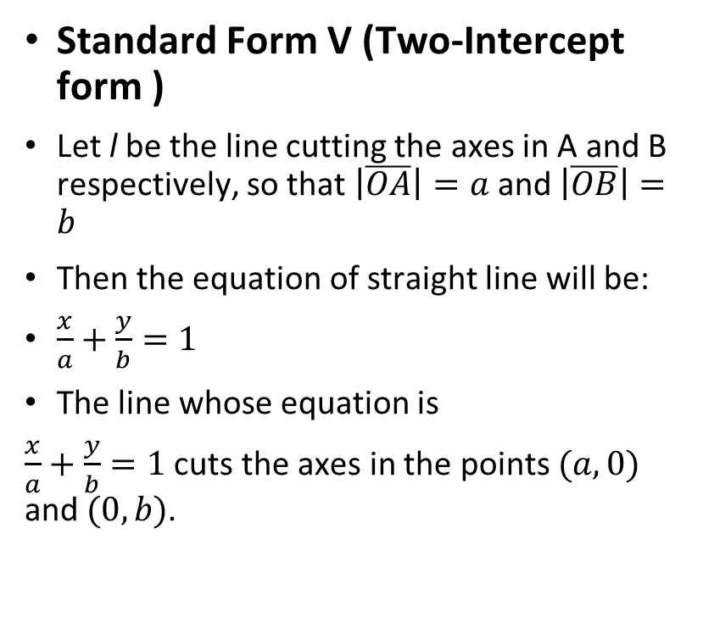
STANDARD FORMS OF THE EQUATION OF STRAIGHT LINE
Standard Form V (Two-Intercept form )
Let l be the line cutting the axes in A and B respectively, so that $\left|\overline{OA}\right|=a$ and $\left|\overline{OB}\right|=b$
Then the equation of straight line will be:
$\frac{x}{a}+\frac{y}{b}=1$
The line whose equation is
$\frac{x}{a}+\frac{y}{b}=1$ cuts the axes in the points $(a,0)$ and $(0,b)$.

Slide 11
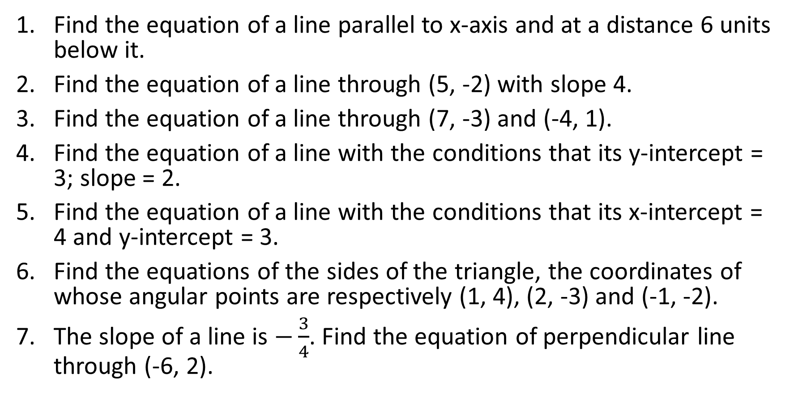
Exercise Problems
Find the equation of a line parallel to x-axis and at a distance 6 units below it.
Find the equation of a line through (5, -2) with slope 4.
Find the equation of a line through (7, -3) and (-4, 1).
Find the equation of a line with the conditions that its y-intercept = 3; slope = 2.
Find the equation of a line with the conditions that its x-intercept = 4 and y-intercept = 3.
Find the equations of the sides of the triangle, the coordinates of whose angular points are respectively (1, 4), (2, -3) and (-1, -2).
The slope of a line is $−\frac{3}{4}$. Find the equation of perpendicular line through (-6, 2).

Slide 12
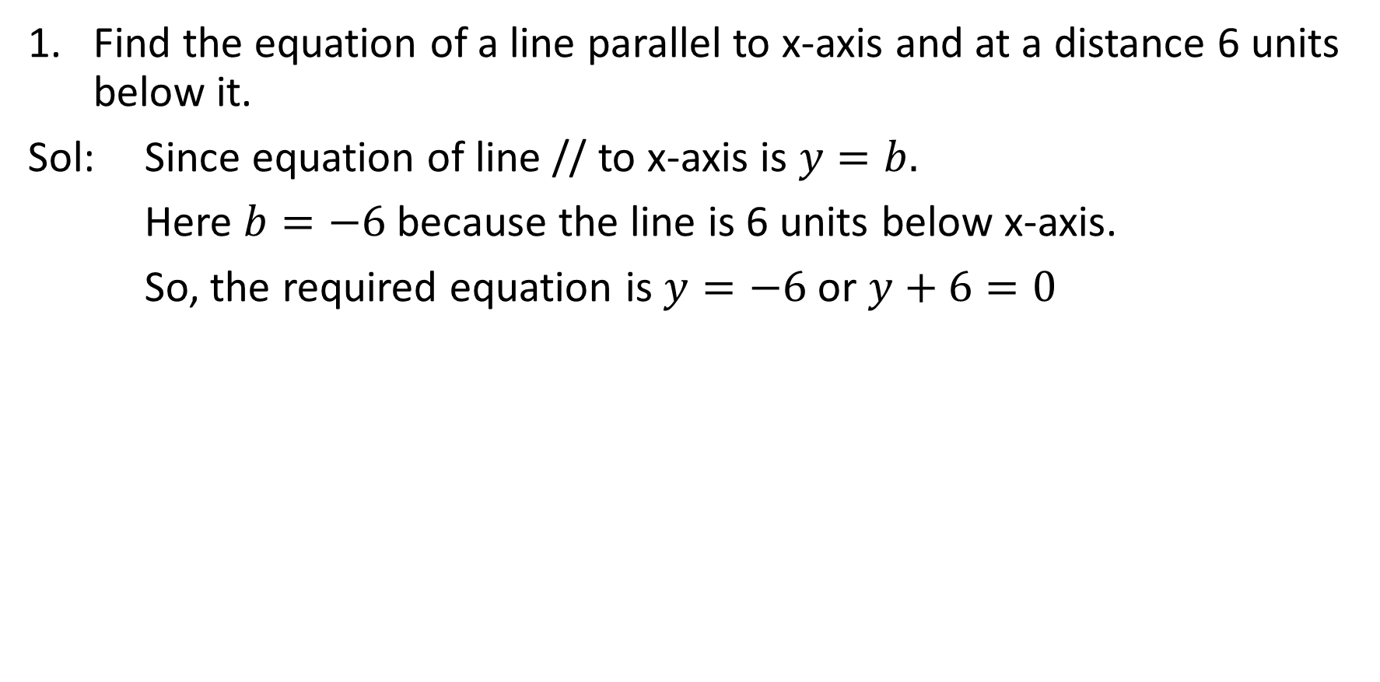
Exercise Problems
Find the equation of a line parallel to x-axis and at a distance 6 units below it.
Sol: Since equation of line // to x-axis is $y=b.$
Here $b=−6$ because the line is 6 units below x-axis.
So, the required equation is $y=−6$ or $y+6=0$

Slide 13
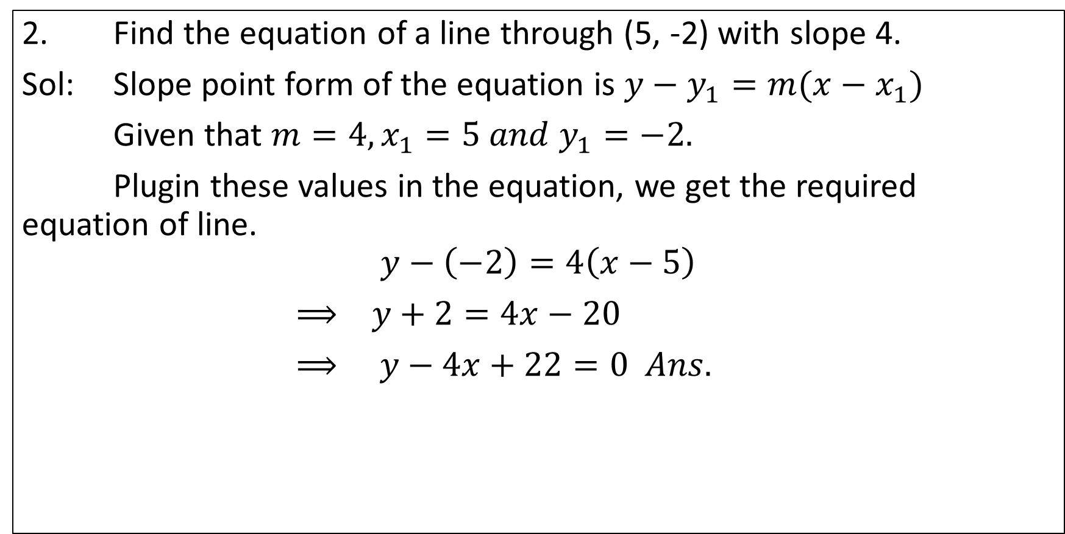
Exercise Problems
2. Find the equation of a line through (5, -2) with slope 4.
Sol: Slope point form of the equation is $y−y_{1}=m(x−x_{1})$
Given that $m=4, x_{1}=5 and y_{1}=−2.$
Plugin these values in the equation, we get the required equation of line.
$$y−\left(−2\right)=4\left(x−5\right)$$
$⟹ y+2=4x−20$
$⟹ y−4x+22=0 Ans.$

Slide 14
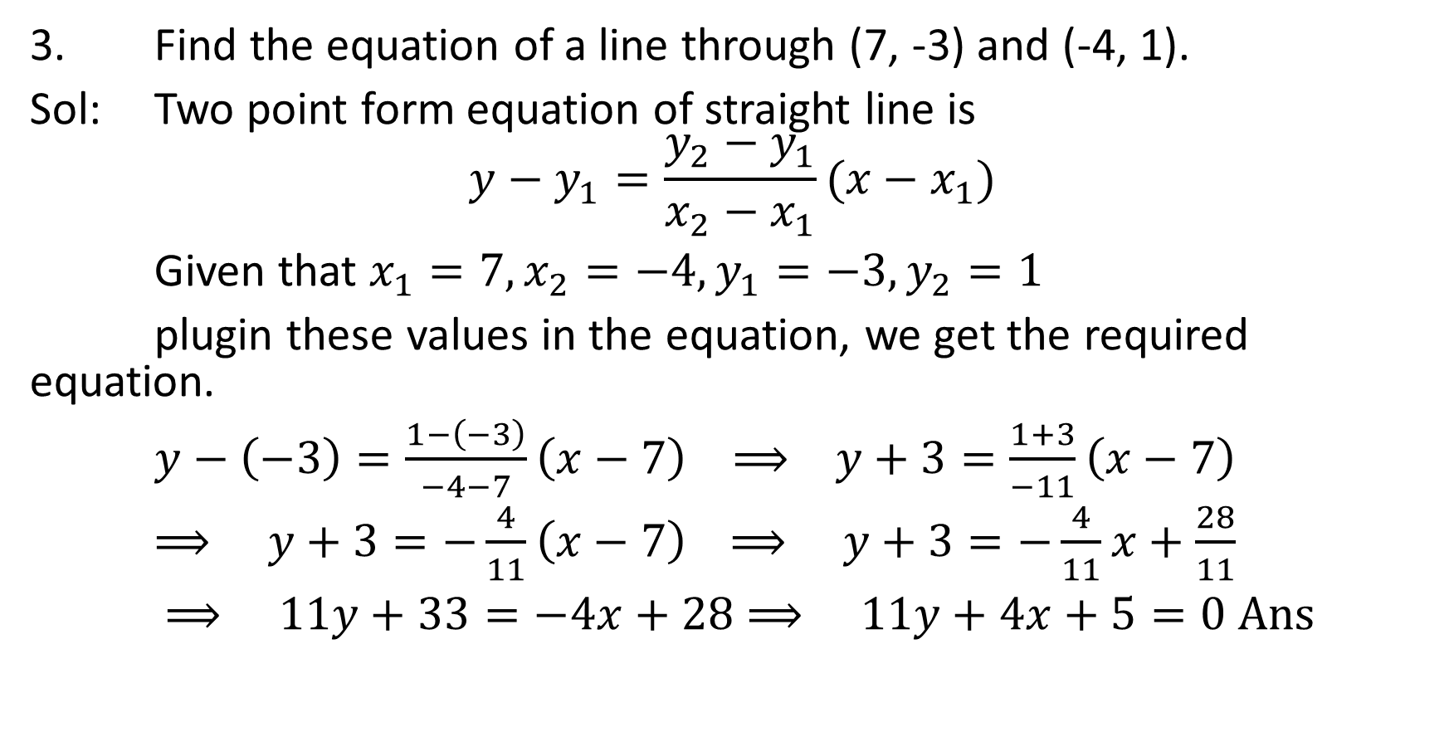
Exercise Problems
3. Find the equation of a line through (7, -3) and (-4, 1).
Sol: Two point form equation of straight line is
$$y−y_{1}=\frac{y_{2}−y_{1}}{x_{2}−x_{1}}(x−x_{1})$$
Given that $x_{1}=7, x_{2}=−4, y_{1}=−3, y_{2}=1$
plugin these values in the equation, we get the required equation.
$y−\left(−3\right)=\frac{1−\left(−3\right)}{−4−7}\left(x−7\right) ⟹ y+3=\frac{1+3}{−11}\left(x−7\right)$
$⟹ y+3=−\frac{4}{11}\left(x−7\right)$ $⟹ y+3=−\frac{4}{11}x+\frac{28}{11}$
$⟹ 11y+33=−4x+28$ $⟹ 11y+4x+5=0 Ans$

Slide 15
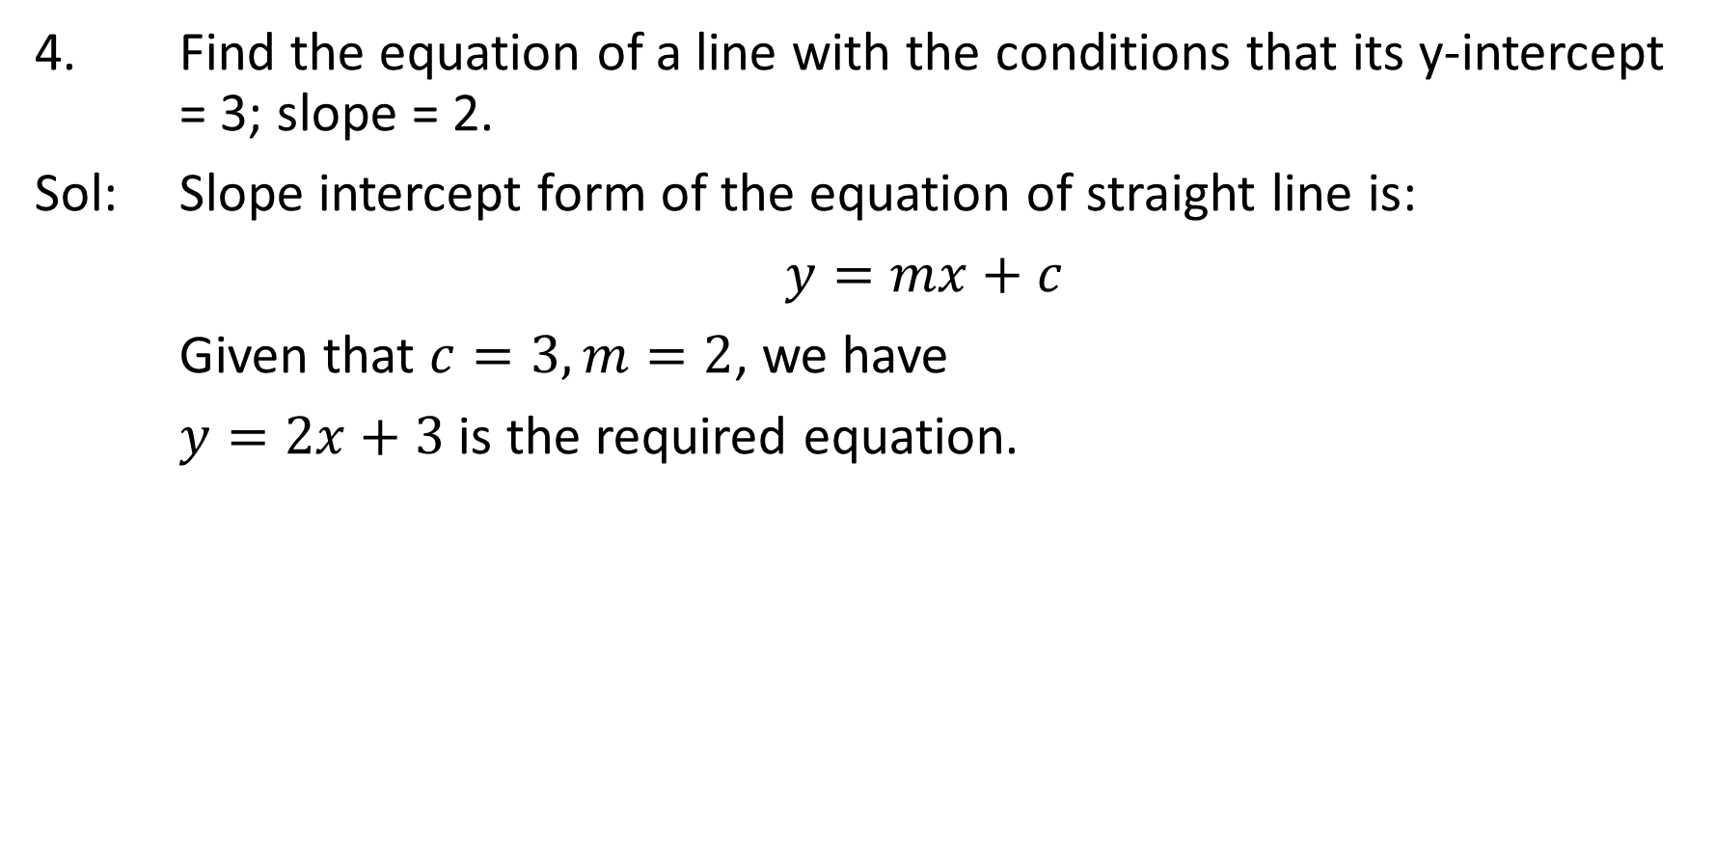
Exercise Problems
4. Find the equation of a line with the conditions that its y-intercept = 3; slope = 2.
Sol: Slope intercept form of the equation of straight line is:
$y=mx+c$
Given that $c=3, m=2$, we have
$y=2x+3$ is the required equation.

Slide 16
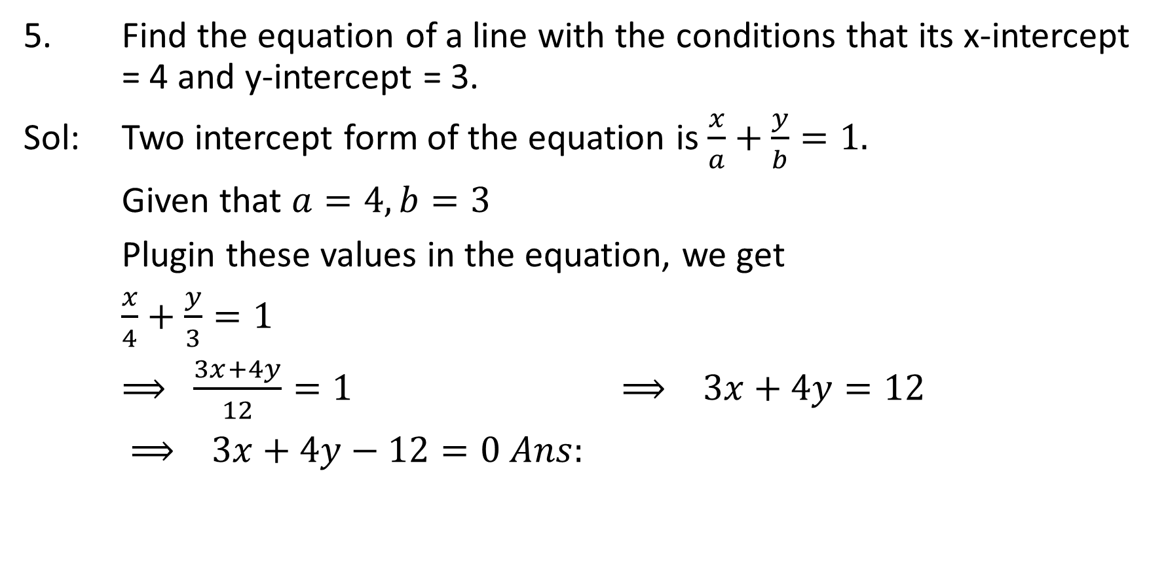
Exercise Problems
5. Find the equation of a line with the conditions that its x-intercept = 4 and y-intercept = 3.
Sol: Two intercept form of the equation is $\frac{x}{a}+\frac{y}{b}=1.$
Given that $a=4, b=3$
Plugin these values in the equation, we get
$\frac{x}{4}+\frac{y}{3}=1$
$⟹ \frac{3x+4y}{12}=1$ $⟹ 3x+4y=12$
$⟹ 3x+4y−12=0 Ans:$

Slide 17
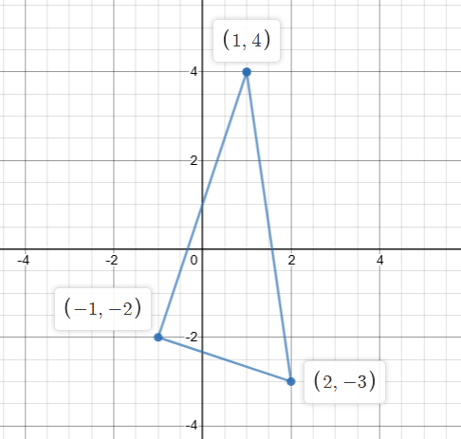
Exercise Problems
6. Find the equations of the sides of the triangle, the coordinates of whose angular points are respectively (1, 4), (2, -3) and (-1, -2).

Slide 18
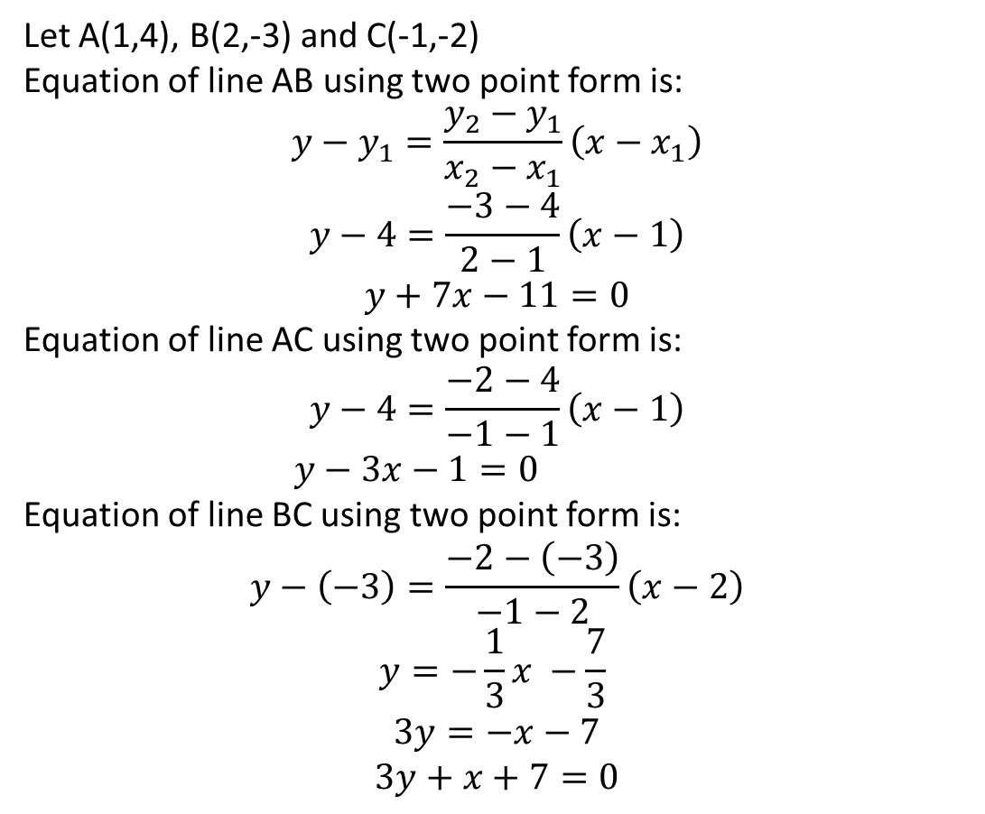
Exercise Problems
Let A(1,4), B(2,-3) and C(-1,-2)
Equation of line AB using two point form is:
$$y−y_{1}=\frac{y_{2}−y_{1}}{x_{2}−x_{1}}\left(x−x_{1}\right)$$
$$y−4=\frac{−3−4}{2−1}\left(x−1\right)$$
$$y+7x−11=0$$
Equation of line AC using two point form is:
$$y−4=\frac{−2−4}{−1−1}\left(x−1\right)$$
$y−3x−1=0$
Equation of line BC using two point form is:
$$y−\left(−3\right)=\frac{−2−\left(−3\right)}{−1−2}\left(x−2\right)$$
$$y=−\frac{1}{3}x −\frac{7}{3}$$
$$3y=−x−7$$
$$3y+x+7=0$$
6. Find the equations of the sides of the triangle, the coordinates of whose angular points are respectively (1, 4), (2, -3) and (-1, -2).

Slide 19
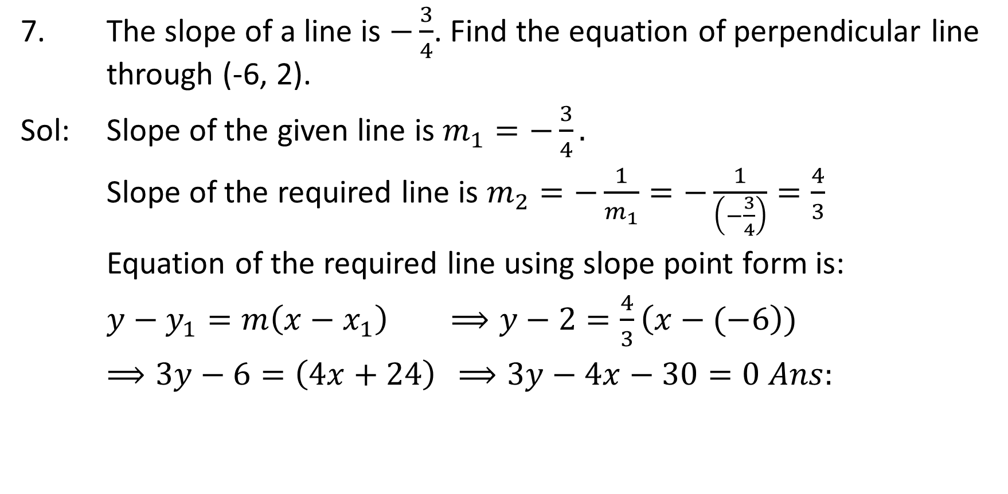
Exercise Problems
7. The slope of a line is $−\frac{3}{4}$. Find the equation of perpendicular line through (-6, 2).
Sol: Slope of the given line is $m_{1}=−\frac{3}{4}.$
Slope of the required line is $m_{2}=−\frac{1}{m_{1}}=−\frac{1}{\left(−\frac{3}{4}\right)}=\frac{4}{3}$
Equation of the required line using slope point form is:
$y−y_{1}=m\left(x−x_{1}\right)$ $⟹y−2=\frac{4}{3}\left(x−(−6\right))$
$⟹3y−6=\left(4x+24\right)$ $⟹3y−4x−30=0 Ans:$

